Slide 1
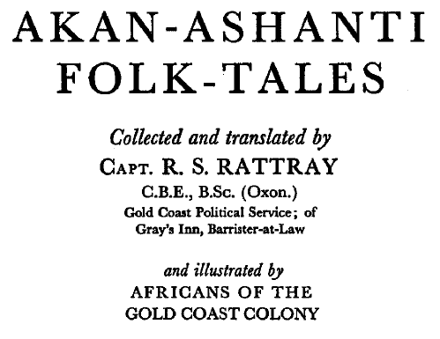
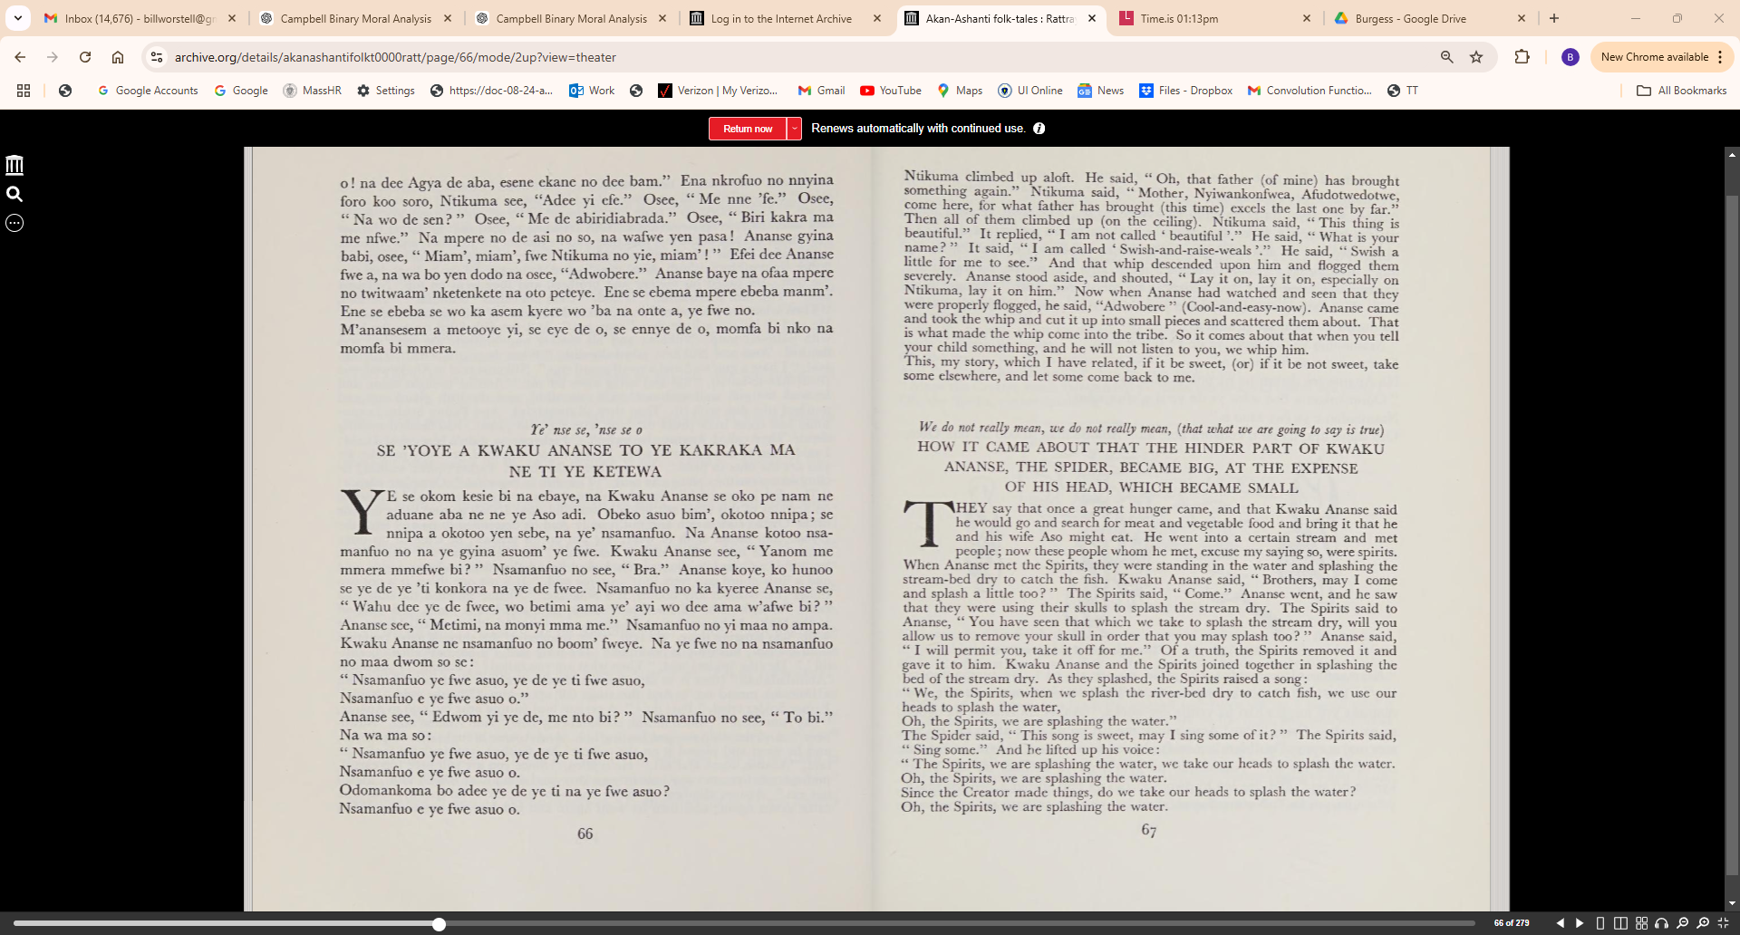

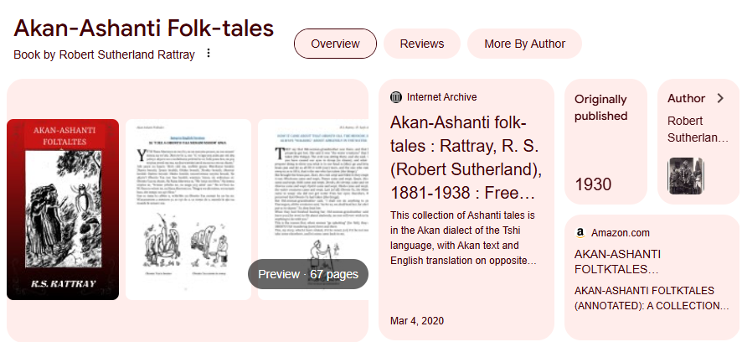
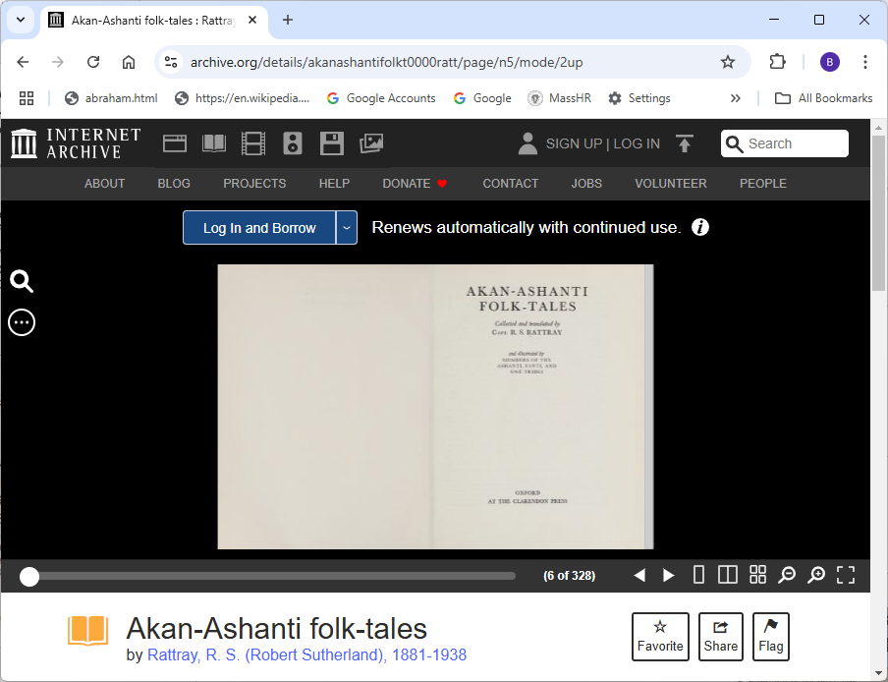
Demo Source Material:
https://archive.org/details/akanashantifolkt0000ratt/page/n5/mode/2up

Slide 2
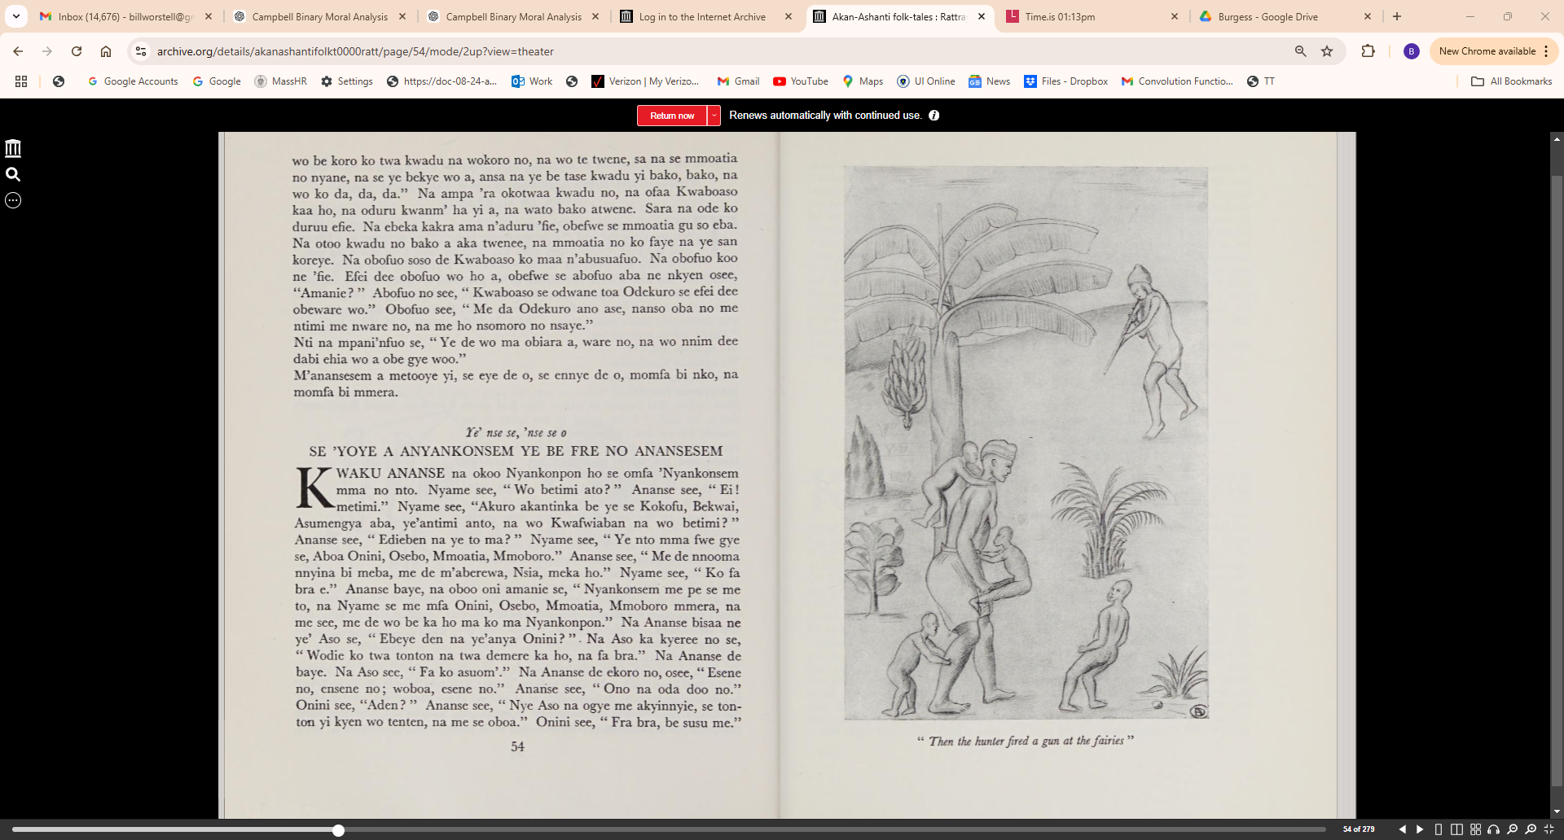

Slide 3
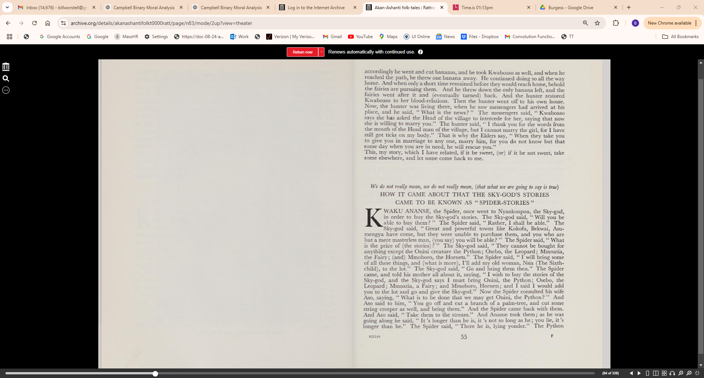
Ananse0
Source Material and
ChatGPT-4o Prompts

Slide 4
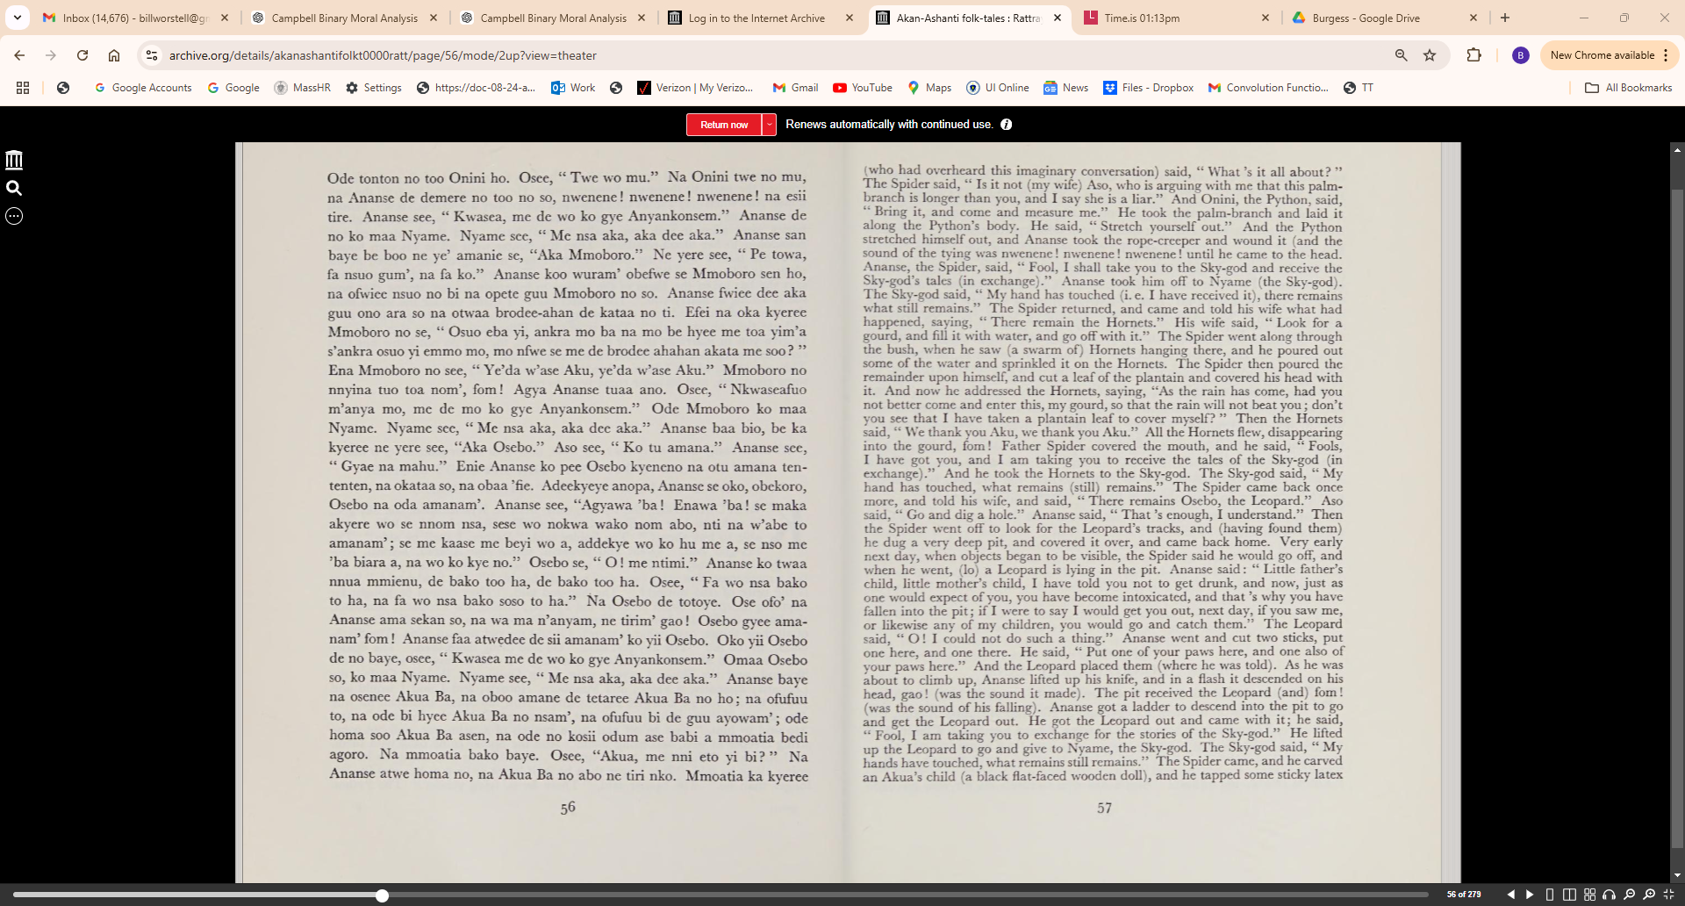

Slide 5
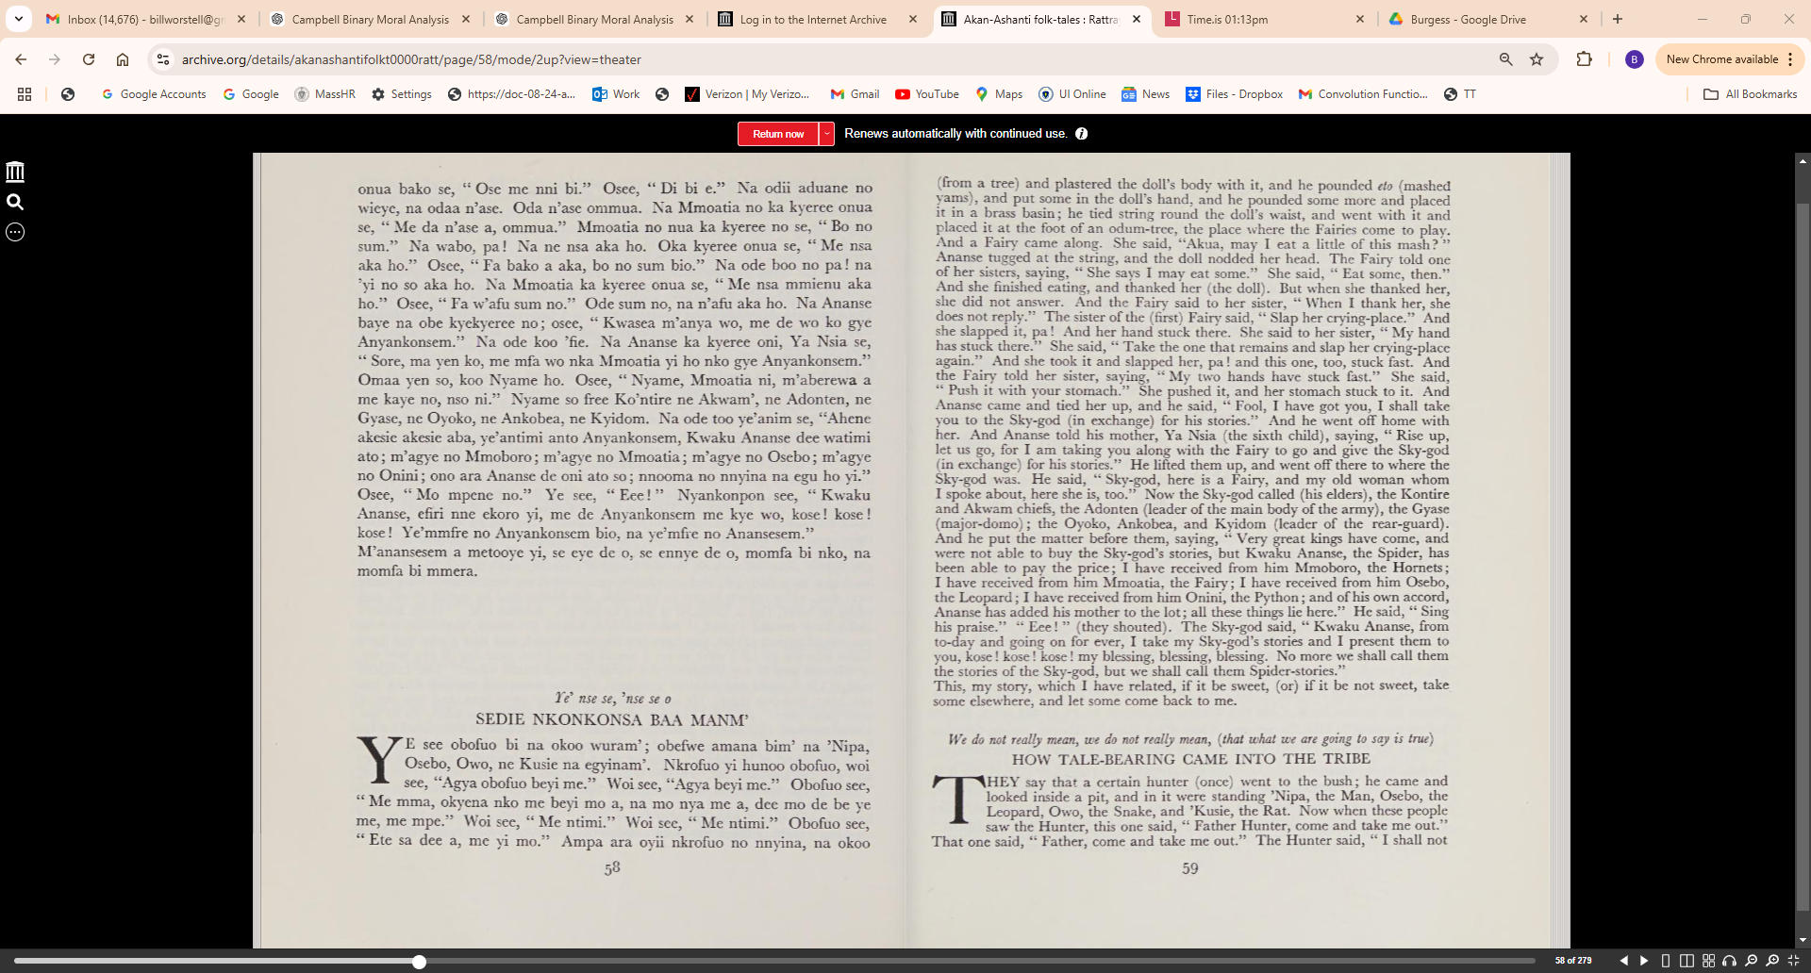

Slide 6
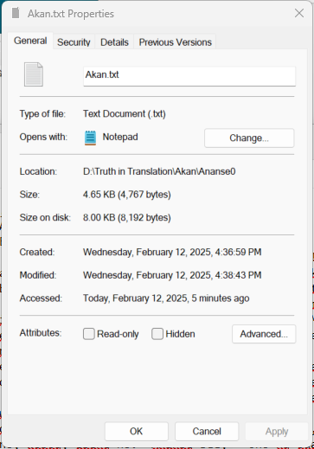
Ie' n.se se, 'nse se o
SE 'YOYE A ANYANKONSEM YE BE FRE NO ANANSESEM
KWAKU ANANSE na okoo Nyankonpon ho se omfa 'Nyankonsem
mma no nto. Nyame see, "Wo betimi ato? " Ananse see, "Ei!
metimi." Nyame see, "Akuro akantinka be ye se Kokofu, Bekwai,
Asumengya aba, ye'antimi anto, na wo Kwafwiaban na wo betimi? "
Ananse see, " Edieben na ye to ma? " Nyame see, "Ye nto mma fwe gv.e
se, Aboa Onini, Osebo, Mmoatia, Mmoboro." Ananse see, " Me de nnooma
nnyina bi meba, me de m'aberewa, Nsia, meka ho." Nyame see, " Ko fa
bra e." Ananse baye, na oboo oni amanie se, " Nyankonsem me pe se me
to, na Nyame se me mfa Onini, Osebo, Mmoatia, Mmoboro mmera, na
me see, me de wo be ka ho ma ko ma Nyankonpon." Na Ananse bisaa ne
ye' Aso se, " Ebeye den na ye'anya Onini? " Na Aso ka kyeree no se,
"Wodie ko twa tonton na twa demere ka ho, na fa bra." Na Ananse de
baye. Na Aso see, " Fa ko asuom'." Na Ananse de ekoro no, osee, "Esene
no, ensene no; woboa, esene no." Ananse see, " Ono na oda doo no."
Onini see, "Aden? " Ananse see, "Nye Aso na ogye me akyinnyie, se ton
ton yi kyen wo tenten, na me se oboa." Onini see, "Fra bra, be susu me."
Ode tonton no too Onini ho. Osee, "Twe wo mu." Na Onini twe no mu,
na Ananse de demere no too no so, nwenene! nwenene! nwenene! na esii
tire. Ananse see, " Kwasea, me de wo ko gye Anyankonsem." Ananse de
no ko maa Nyame. Nyame see, " Me nsa aka, aka dee aka." Ananse san
baye be boo ne ye' amanie se, "Aka Mmoboro." Ne yere see, " Pe towa,
fa nsuo gum', na fa ko." Ananse koo wuram' obefwe se Mmoboro sen ho,
na ofwiee nsuo no bi na opete guu Mmoboro no so. Ananse fwiee dee aka
guu ono ara so na otwaa brodee-ahan de kataa no ti. Efei na oka kyeree
Mmoboro no se, " Osuo eba yi, ankra mo ba na mo be hyee me toa yim'a
s'ankra osuo yi emmo mo, mo nfwe se me de brodee ahahan akata me soo? "
Ena Mmoboro no see, "Ye'da w'ase Aku, ye'da w'ase Aku." Mmoboro no
nnyina tuo toa nom', fom! Agya Ananse tuaa ano. Osee, "Nkwaseafuo
m'anya mo, me de mo ko gye Anyankonsem." Ode Mmoboro ko maa
Nyame. Nyame see, " Me nsa aka, aka dee aka." Ananse baa bio, be ka
kyeree ne yere see, "Aka Osebo." Aso see, " Ko tu amana." Ananse see,
" Gyae na mahu." Enie Ananse ko pee Osebo kyeneno na otu amana ten
tenten, na okataa so, na obaa 'fie. Adeekyeye anopa, Ananse se oko, obekoro,
Osebo na oda amanam'. Ananse see, "Agyawa 'ba! Enawa 'ba! se maka
akyere wo se nnom nsa, sese wo nokwa wako nom abo, nti na w'abe to
amanam'; se me kaase me beyi wo a, addekye wo ko hu me a, se nso me
'ba biara a, na wo ko kye no
Osebo se, " 0! me ntimi." Ananse ko twaa
nnua mmienu, de bako too ha, de bako too ha. Osee, " Fa wo nsa bako
to ha, na fa wo nsa bako soso to ha." Na Osebo de totoye. Ose ofo' na
Ananse ama sekan so, na wa ma n'anyam, ne tirim' gao! Osebo gyee ama
nam' fom! Ananse faa atwedee de sii amanam' ko yii Osebo. Oko yii Osebo
de no baye, osee, " Kwasea me de wo ko gye Anyankonsem." Omaa Osebo
so, ko maa Nyame. Nyame see, " Me nsa aka, aka dee aka." Ananse baye
na osenee Akua Ba, na oboo amane de tetaree Akua Ba no ho; na ofufuu
to, na ode bi hyee Akua Ba no nsam', na ofufuu bi de guu ayowam'; ode
homa soo Akua Ba asen, na ode no kosii odum ase babi a mmoatia bedi
agoro. Na mmoatia bako baye. Osee, "Akua, me nni eto yi bi? " Na
Ananse atwe homa no, na Akua Ba no abo ne tiri nko. Mmoatia ka kyeree onua bako se, "Ose me nni bi." Osee, "Di bi e." Na odi aduane no
wieye, na odaa n'ase. Oda n'ase ommua. Na Mmoatia no ka kyeree onua
se, "Me da n'ase a, ommua." Mmoatia no nua ka kyeree no se, "Bo no
sum." Na wabo, pa! Na ne nsa aka ho. Oka kyeree onua se, "Me nsa
aka ho." Osee, " Fa bako a aka, bo no sum bio." Na ode boo no pa! na
'yi no so aka ho. Na Mmoatia ka kyeree onua se, "Me nsa mmienu aka
ho." Osee, " Fa w'afu sum no." Ode sum no, na n'afu aka ho. Na Ananse
baye na obe kyekyeree no; osee, " Kwasea m'anya wo, me de wo ko gye
Anyankonsem." Na ode koo 'fie. Na Ananse ka kyeree oni, Ya Nsia se,
" Sore, ma yen ko, me mfa wo nka Mmoatia yi ho nko gye Anyankonsem."
Omaa yen so, koo Nyame ho. Osee, "Nyame, Mmoatia ni, m'aberewa a
me kaye no, nso ni." Nyame so free Ko'ntire ne Akwam', ne Adonten, ne
Gyase, ne Oyoko, ne Ankobea, ne Kyidom. Na ode too ye'anim se, "Ahene
akesie akesie aba, ye'antimi anto Anyankonsem, Kwaku Ananse dee watimi
ato; m'agye no Mmoboro; m'agye no Mmoatia; m'agye no Osebo; m'agye
no Onini; ono ara Ananse de oni ato so; nnooma no nnyina na egu ho yi."
Osee, "Mo mpene no." Ye see, " Eee! " Nyankonpon see, " Kwaku
Ananse, efiri nne ekoro yi, me de Anyankonsem me kye wo, kose! kose!
kose! Ye'mmfre no Anyankonsem bio, na ye'mfre no Anansesem."
M'anansesem a metooye yi, se eye de o, se ennye de o, momfa bi nko, na
momfa bi mmera.

Slide 7
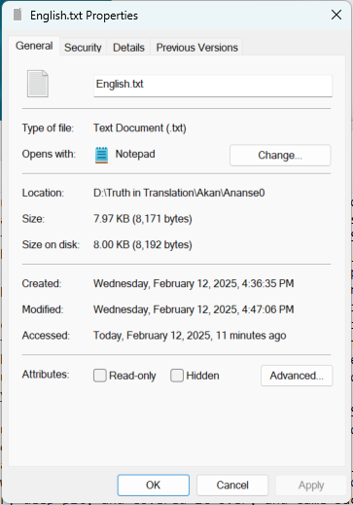
We do not really mean, we do not really mean, (that what we are going to say is true)
HOW IT GAME ABOUT THAT THE SKY-GOD'S STORIES
CAME TO BE KNOWN AS " SPIDER-STORIES "
KWAKU ANANSE, the Spider, once went to Nyankonpon, the Sky-god,
in order to buy the Sky-god's stories. The Sky-god said, "Will you be
able to buy them? " The Spider said, " Rather, I shall be able." The
Sky-god said, " Great and powerful towns like Kokofu, Bekwai, Asu
mengya have come, but they were unable to purchase them, and you who are
but a mere masterless man, (you say) you will be able? " The Spider said, "What
is the price of (the stories) ? " The Sky-god said, "They cannot be bought for
anything except the Onini creature the Python; Osebo, the Leopard; Mmoatia,
the Fairy; (and) Mmoboro, the Hornets." The Spider said, " I will bring some
of all these things, and (what is more), I'll add my old woman, Nsia (The Sixth
child), to the lot." The Sky-god said, " Go and bring them then." The Spider
came, and told his mother all about it, saying, " I wish to buy the stories of the
Sky-god, and the Sky-god says I must bring Onini, the Python; Osebo, the
Leopard; Mmoatia, a Fairy; and Mmoboro, Hornets; and I said I would add
you to the lot and go and give the Sky-god." Now the Spider consulted his wife
Aso, saying, " What is to be done that we may get Onini, the Python? " And
Aso said to him, "You go off and cut a branch of a palm-tree, and cut some
string creeper as well, and bring them." And the Spider came back with them.
And Aso said, "Take them to the stream." And Ananse took them; as he was
going along he said, " It's longer than he is, it's not so long as he; you lie, it's
longer than he." The Spider said, "There he is, lying yonder." The Python (who had overheard this imaginary conversation) said, "What's it all about?"
The Spider said, " Is it not (my wife) Aso, who is arguing with me that this palm
branch is longer than you, and I say she is a liar." And Onini, the Python, said,
" Bring it, and come and measure me." He took the palm-branch and laid it
along the Python's body. He said, " Stretch yourself out." And the Python
stretched himself out, and Ananse took the rope-creeper and wound it (and the
sound of the tying was nwenene! nwenene! nwenene! until he came to the head.
Ananse, the Spider, said, " Fool, I shall take you to the Sky-god and receive the
Sky-god's tales (in exchange)." Ananse took him off to Nyame (the Sky-god).
The Sky-god said, "My hand has touched (i. e. I have received it), there remains
what still remains." The Spider returned, and came and told his wife what had
happened, saying, " There remain the Hornets." His wife said, " Look for a
gourd, and fill it with water, and go off with it." The Spider went along through
the bush, when he saw (a swarm of) Hornets hanging there, and he poured out
some of the water and sprinkled it on the Hornets. The Spider then poured the
remainder upon himself, and cut a leaf of the plantain and covered his head with it. And now he addressed the Hornets, saying, "As the rain has come, had you
not better come and enter this, my gourd, so that the rain will not beat you; don't
you see that I have taken a plantain leaf to cover myself? " Then the Hornets
said, "We thank you Aku, we thank you Aku." All the Hornets flew, disappearing
into the gourd, fom! Father Spider covered the mouth, and he said, "Fools,
I have got you, and I am taking you to receive the tales of the Sky-god (in
exchange)." And he took the Hornets to the Sky-god. The Sky-god said, " Myhand has touched, what remains (still) remains." The Spider came back oncemore, and told his wife, and said, "There remains Osebo, the Leopard."
Aso said, " Go and dig a hole." Ananse said, " That's enough, I understand." Then
the Spider went off to look for the Leopard's tracks, and (having found them)
he dug a very deep pit, and covered it over, and came back home. Very early
next day, when objects began to be visible, the Spider said he would go off, and
when he went, (lo) a Leopard is lying in the pit. Ananse said: " Little father's
child, little mother's child, I have told you not to get drunk, and now, just as
one would expect of you, you have become intoxicated, and that's why you have
fallen into the pit; if I were to say I would get you out, next day, if you saw me,
or likewise any of my children, you would go and catch them." The Leopard
said, " 0! I could not do such a thing." Ananse went and cut two sticks, put
one here, and one there. He said, " Put one of your paws here, and one also of
your paws here." And the Leopard placed them (where he was told). As he was
about to climb up, Ananse lifted up his knife, and in a flash it descended on his
head, gao! (was the sound it made). The pit received the Leopard (and) fom!
(was the sound of his falling). Ananse got a ladder to descend into the pit to go
and get the Leopard out. He got the Leopard out and came with it; he said,
" Fool, I am taking you to exchange for the stories of the Sky-god." He lifted
up the Leopard to go and give to Nyame, the Sky-god. The Sky-god said, "My
hands have touched, what remains still remains." The Spider came, and he carved
an Akua's child (a black flat-faced wooden doll), and he tapped some sticky latex (from a tree) and plastered the doll's body with it, and he pounded eto (mashed
yams), and put some in the doll's hand, and he pounded some more and placed
it in a brass basin; he tied string round the doll's waist, and went with it and
placed it at the foot of an odum-tree, the place where the Fairies come to play.
And a Fairy came along. She said, "Akua, may I eat a little of this mash? "
Ananse tugged at the string, and the doll nodded her head. The Fairy told one
of her sisters, saying, " She says I may eat some." She said, " Eat some, then."
And she finished eating, and thanked her (the doll). But when she thanked her,
she did not answer. And the Fairy said to her sister, "When I thank her, she
does not reply." The sister of the (first) Fairy said, " Slap her crying-place." And
she slapped it, pa! And her hand stuck there. She said to her sister, " My hand
has stuck there." She said, "Take the one that remains and slap her crying-place
again." And she took it and slapped her, pa! and this one, too, stuck fast. And
the Fairy told her sister, saying, "My two hands have stuck fast." She said,
" Push it with your stomach." She pushed it, and her stomach stuck to it. And
Ananse came and tied her up, and he said, " Fool, I have got you, I shall take
you to the Sky-god (in exchange) for his stories." And he went off home with
her. And Ananse told his mother, Ya Nsia (the sixth child), saying, " Rise up,
let us go, for I am taking you along with the Fairy to go and give the Sky-god
(in exchange) for his stories." He lifted them up, and went off there to where the
Sky-god was. He said, " Sky-god, here is a Fairy, and my old woman whom
I spoke about, here she is, too." Now the Sky-god called (his elders), the Kontire
and Akwam chiefs, the Adonten (leader of the main body of the army), the Gyase
(major-domo); the Oyoko, Ankobea, and Kyidom (leader of the rear-guard).
And he put the matter before them, saying, "Very great kings have come, and
were not able to buy the Sky-god's stories, but Kwaku Ananse, the Spider, has
been able to pay the price; I have received from him Mmoboro, the Hornets;
I have received from him Mmoatia, the Fairy; I have received from him Osebo,
the Leopard; I have received from him Onini, the Python; and of his own accord,
Ananse has added his mother to the lot; all these things lie here." He said, " Sing
his praise." " Eee! " (they shouted). The Sky-god said, " Kwaku Ananse, from
to-day and going on for ever, I take my Sky-god's stories and I present them to
you, kose! kose! kose! my blessing, blessing, blessing. No more we shall call them
the stories of the Sky-god, but we shall call them Spider-stories."
This, my story, which I have related, if it be sweet, (or) if it be not sweet, take
some elsewhere, and let some come back to me.

